Slide 1
How Optimists Triumph and Change Happens
Robin Collins
CLND Event October 1, 2026

Slide 2
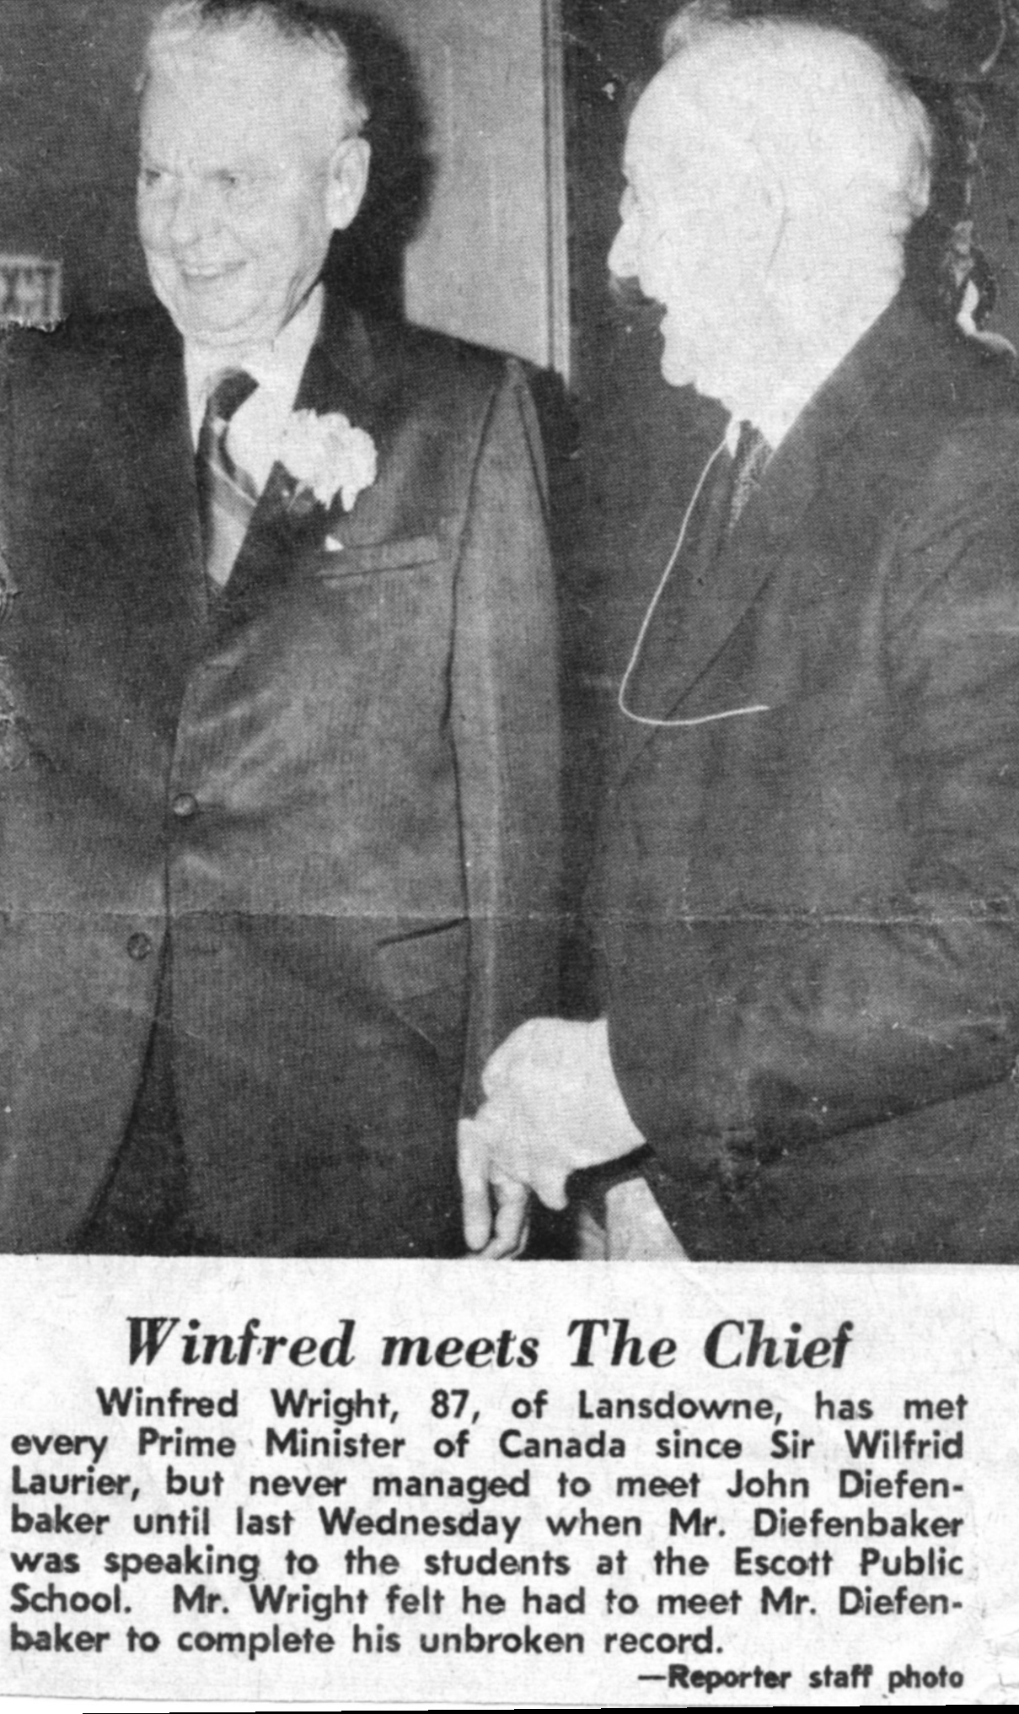

Slide 3
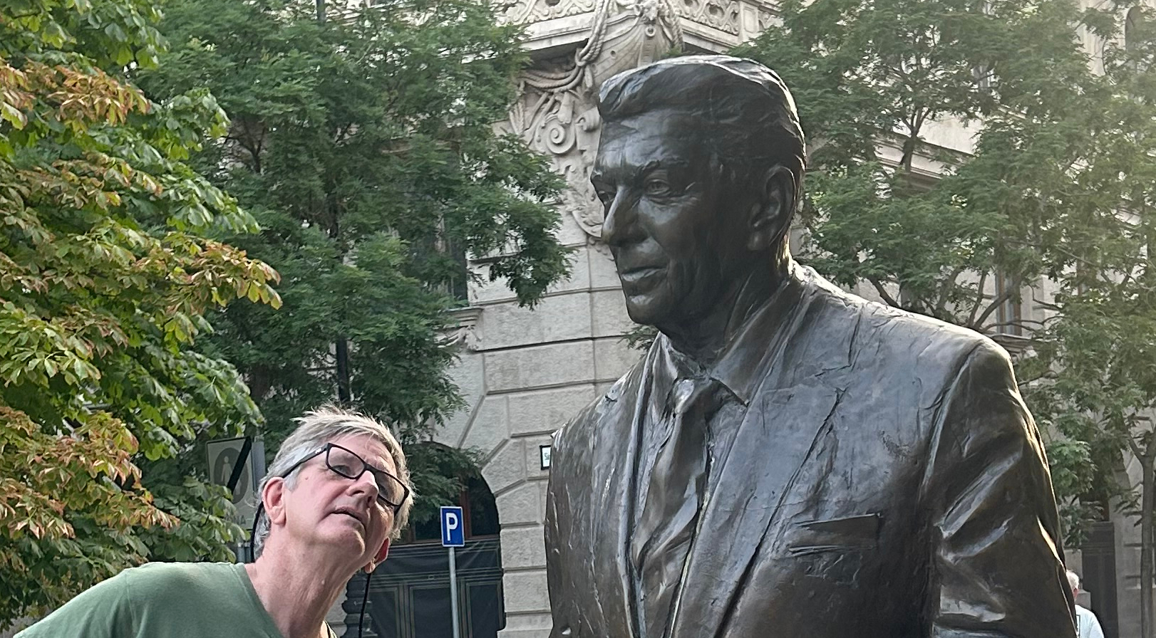

Slide 4
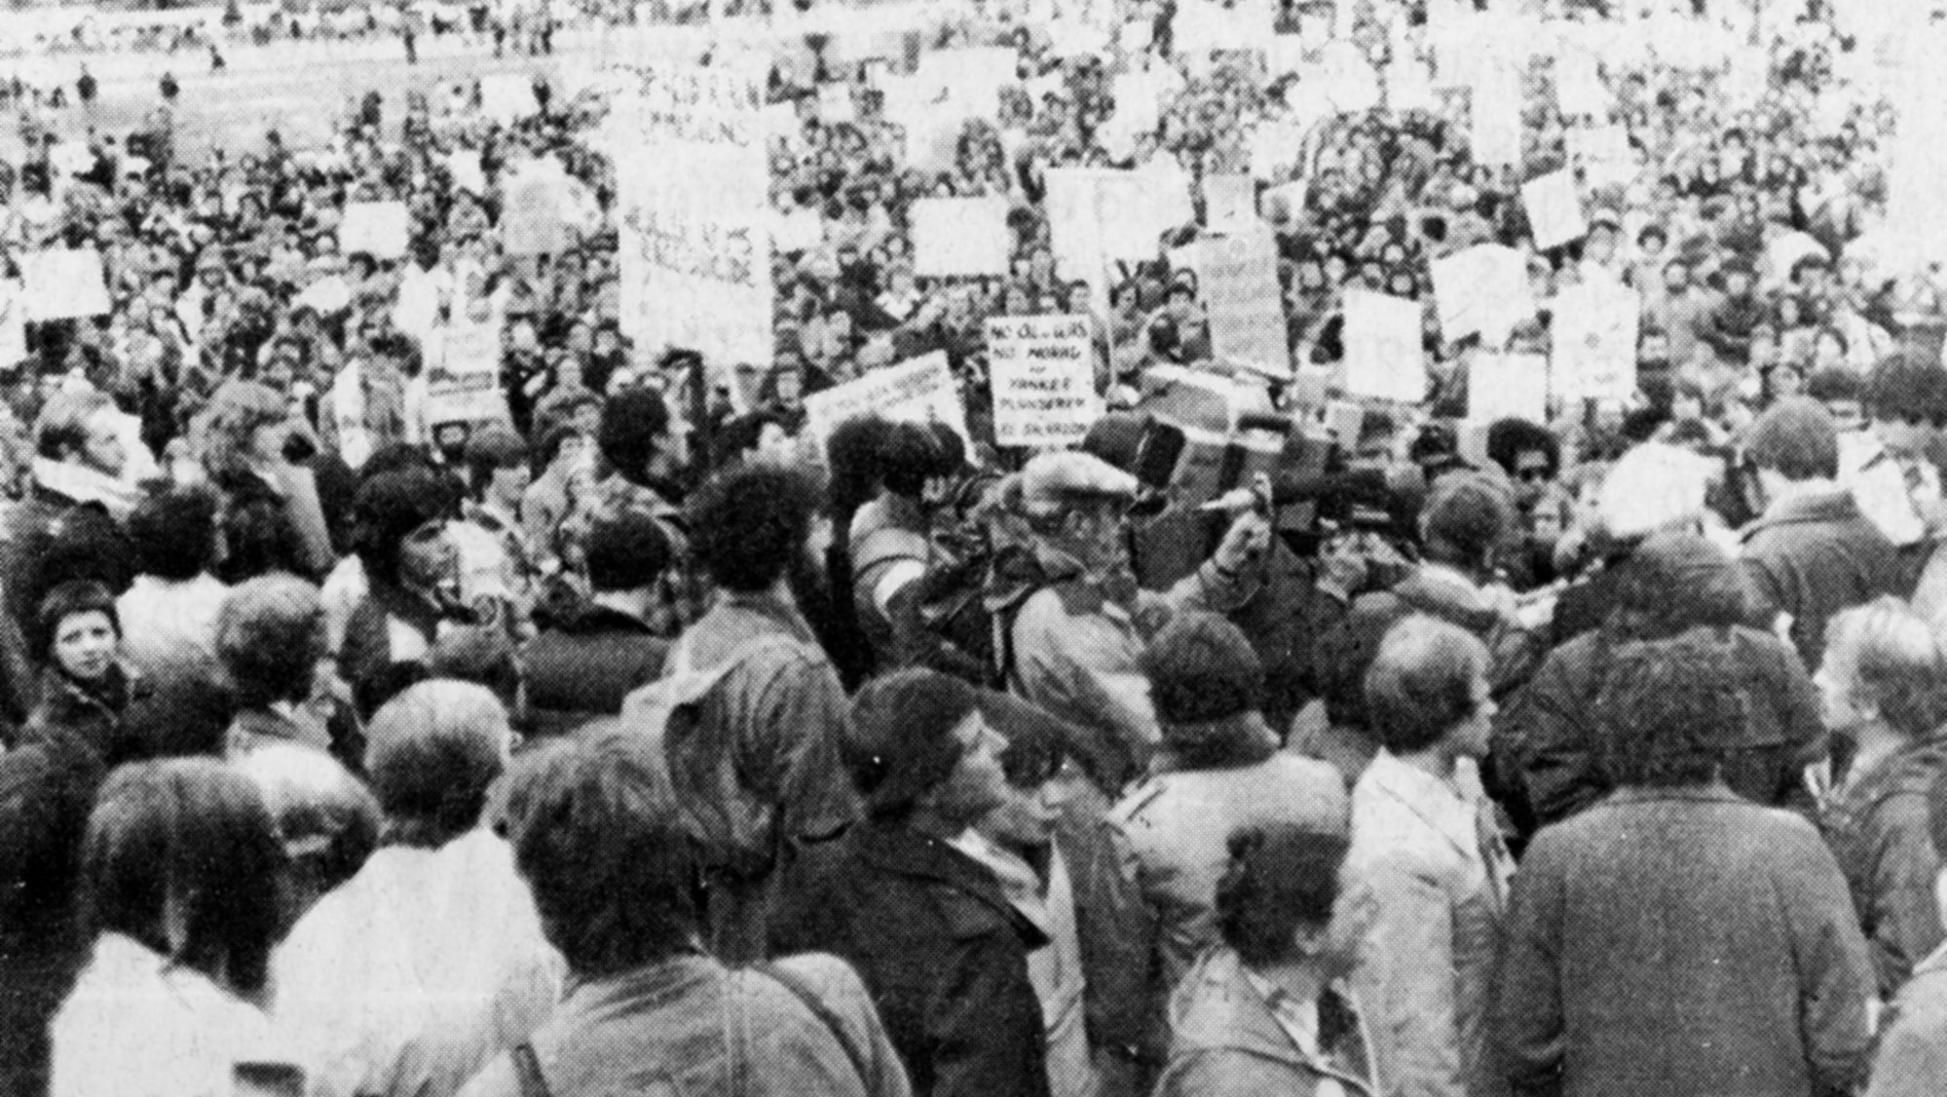

Slide 5
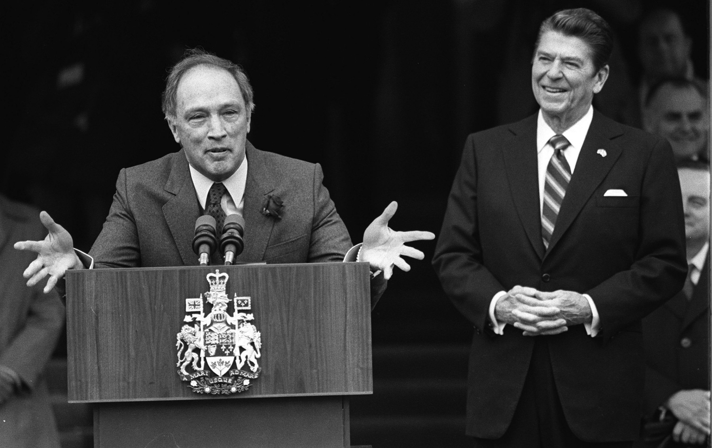

Slide 6
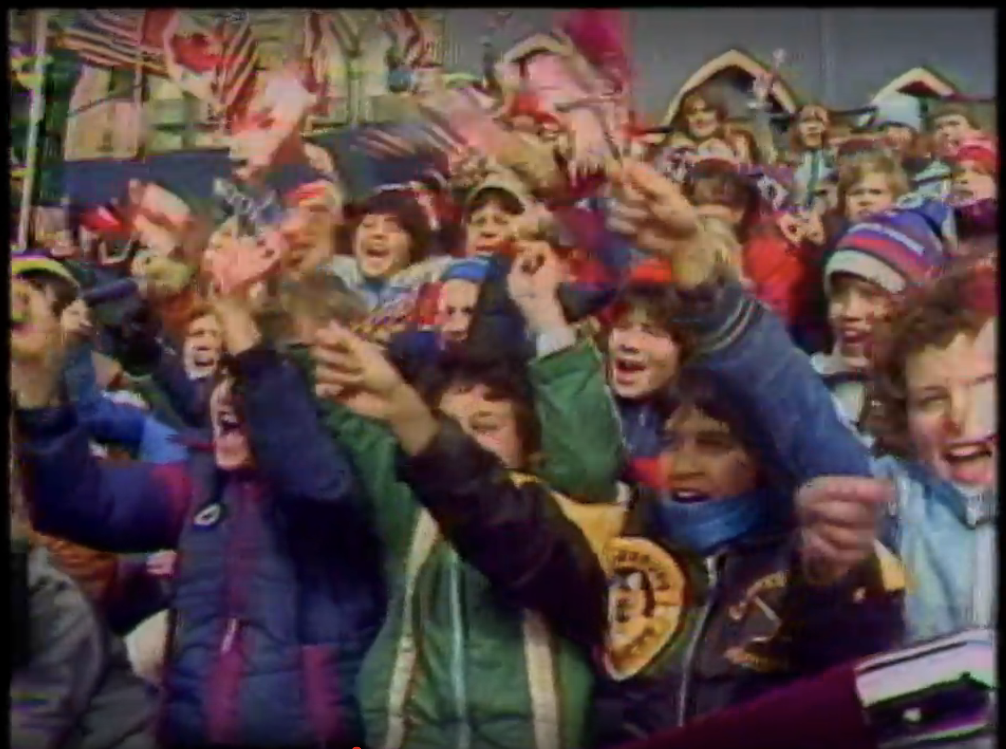

Slide 7
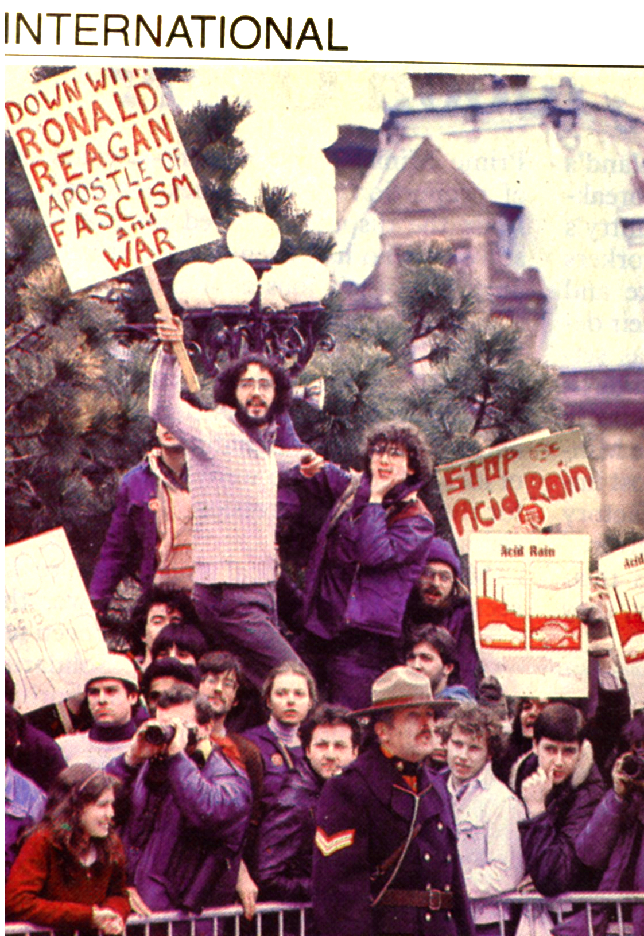

Slide 8
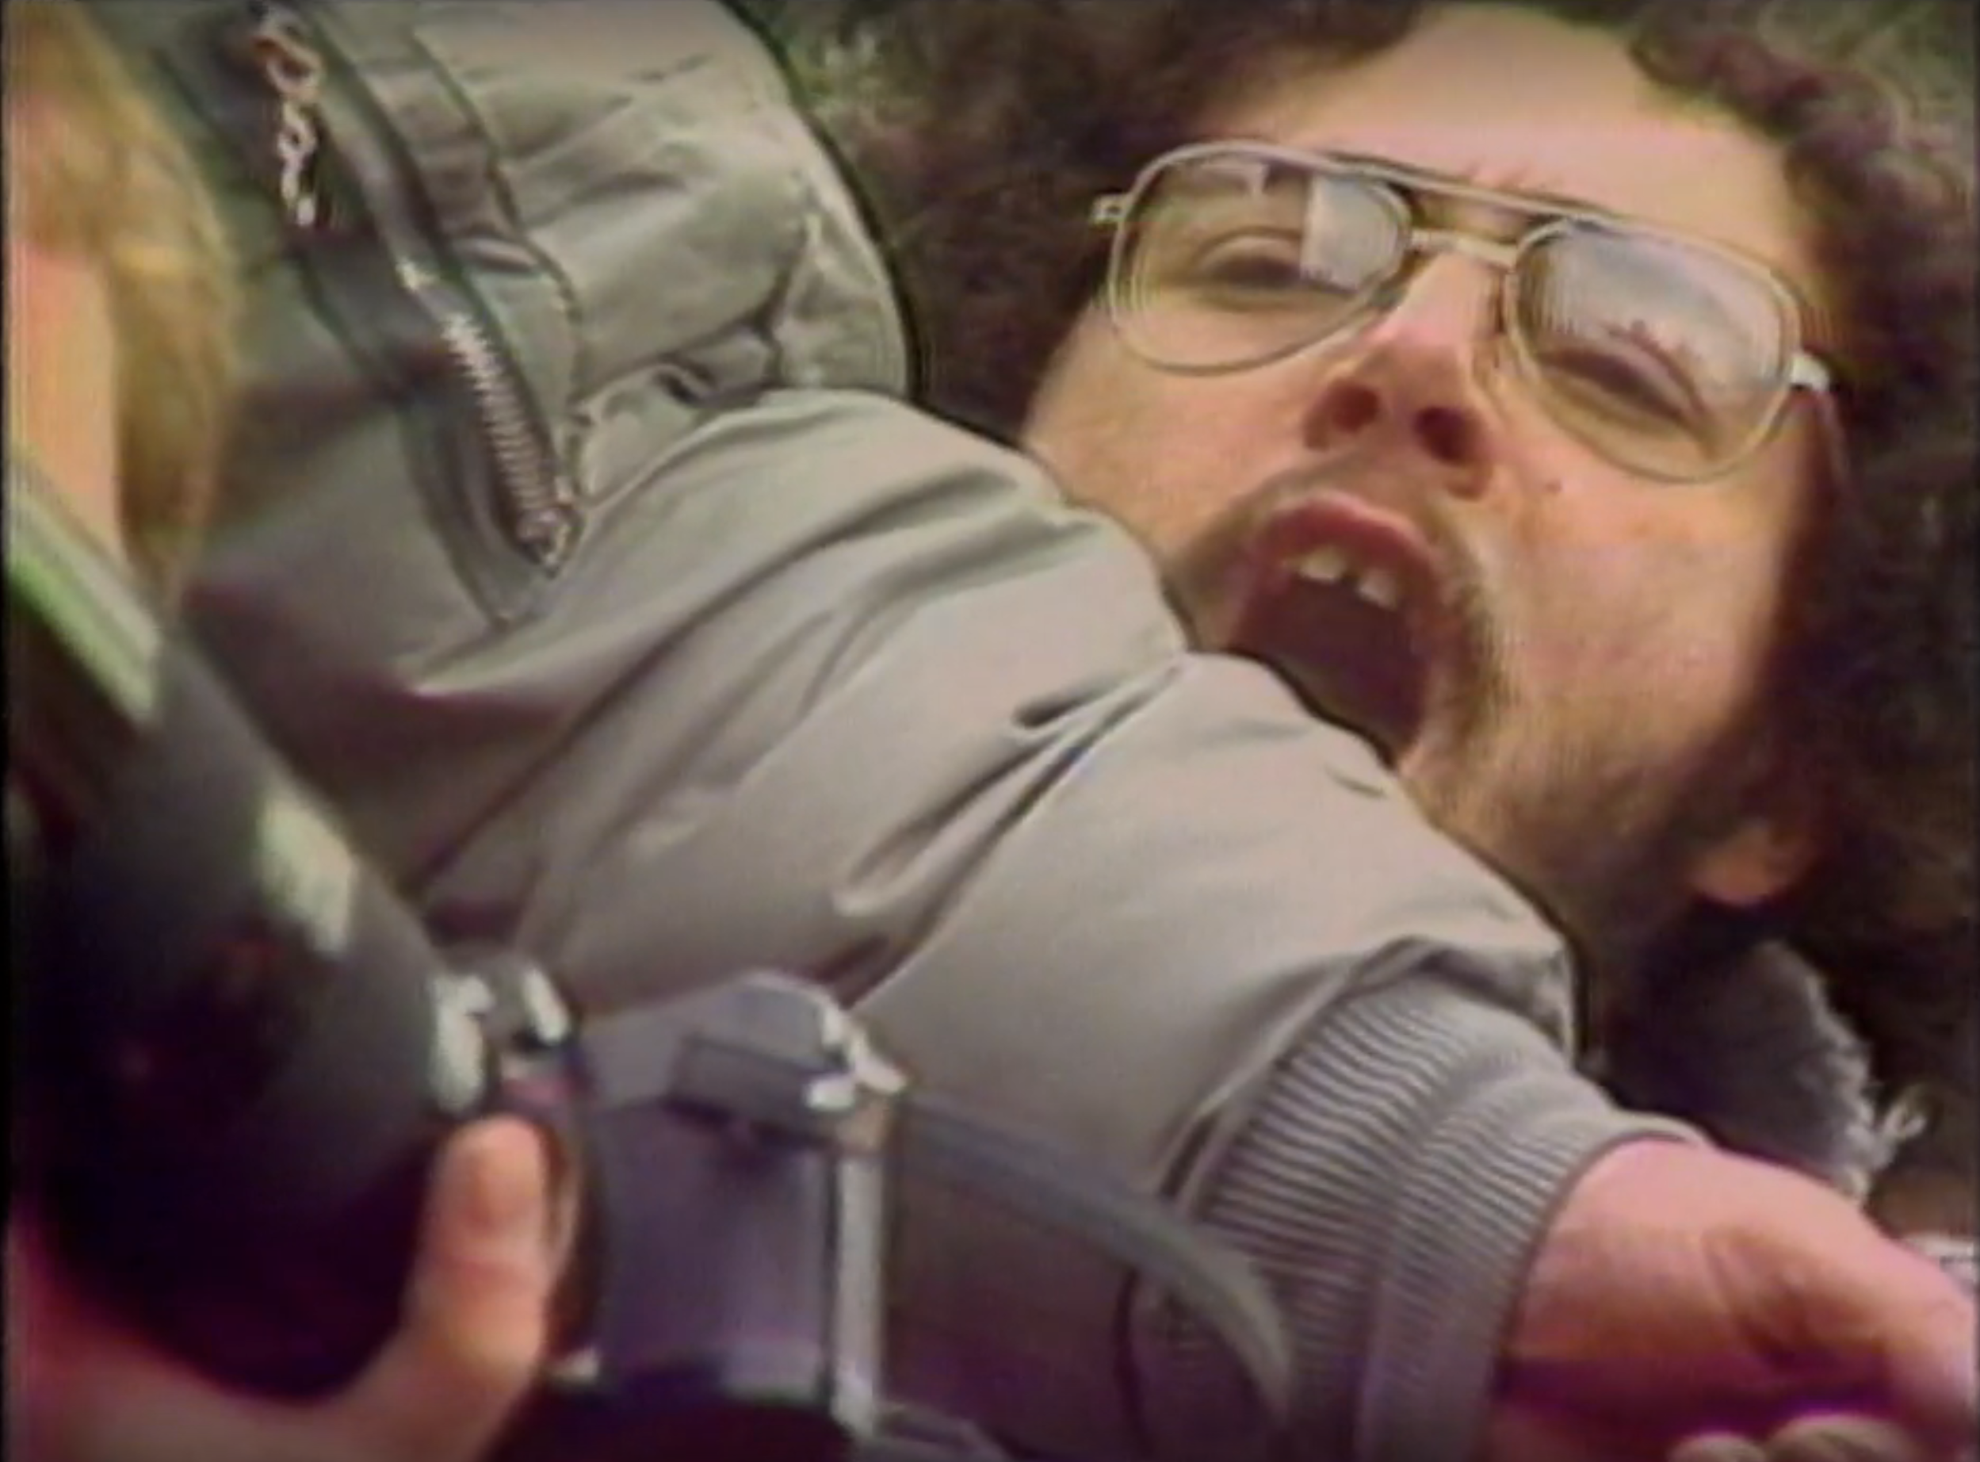

Slide 9
Pandemics
Climate Change
Nuclear Weapons/Nuclear War

Slide 10
COVID 19
15 – 35 million dead
20 million saved
5.5 billion vaccinated
Moderna Vaccine in 66 days
Gene-sequenced in 10 days

Slide 12
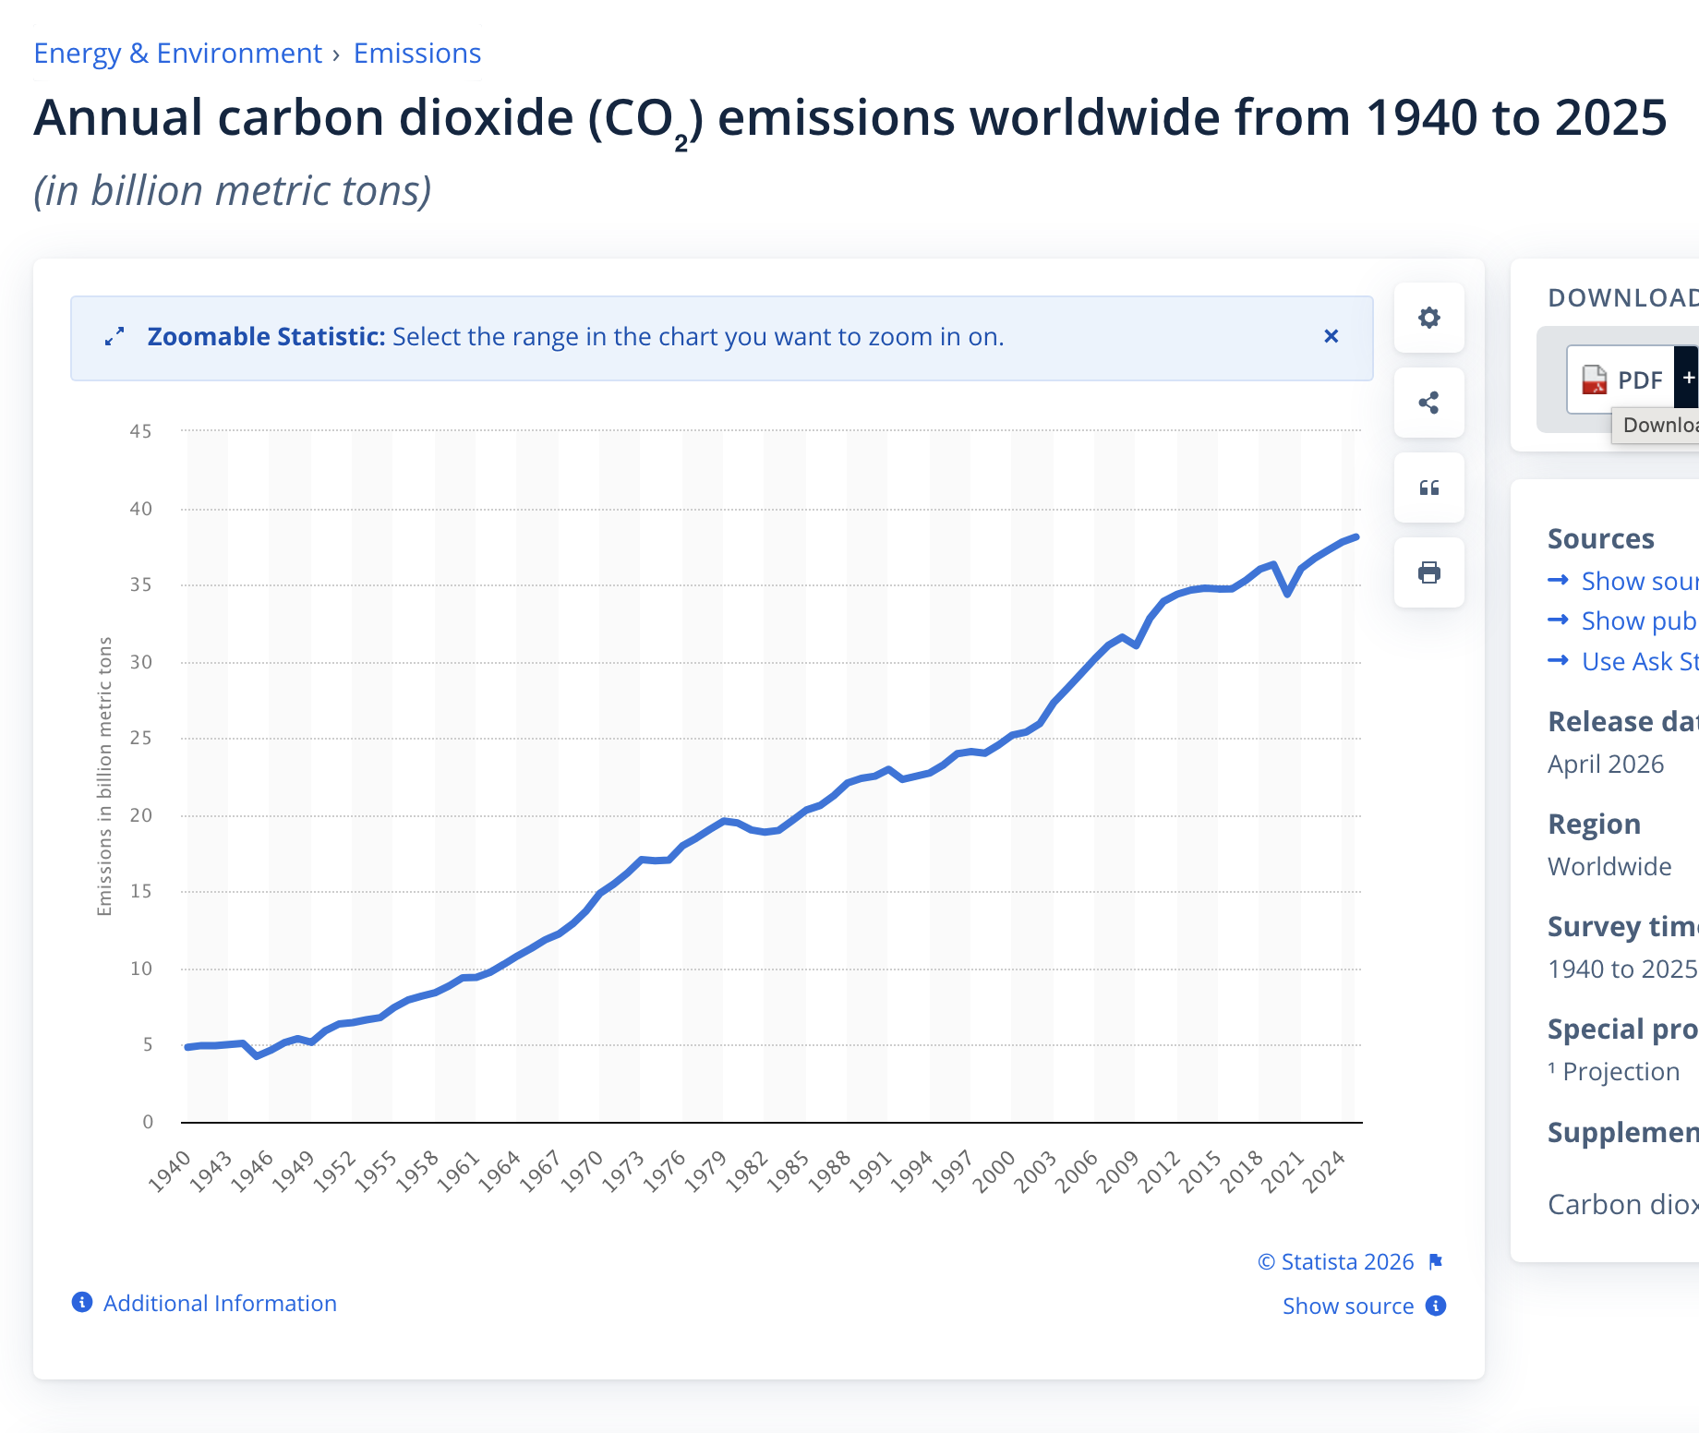

Slide 13
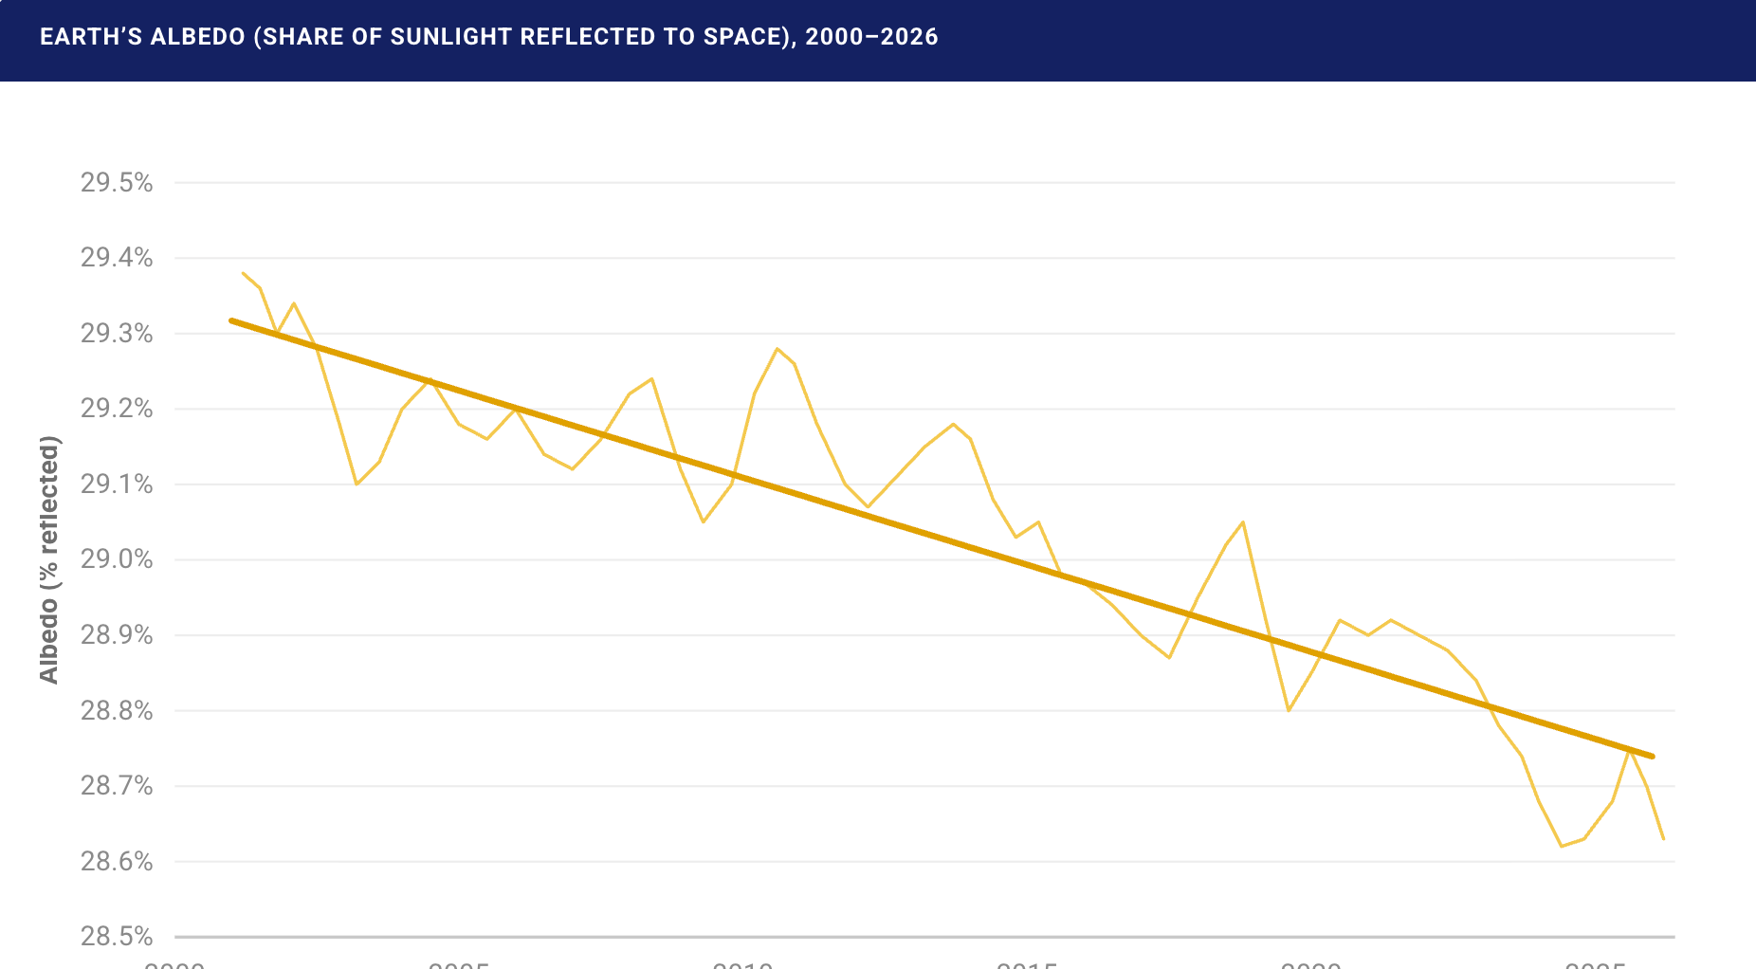

Slide 14
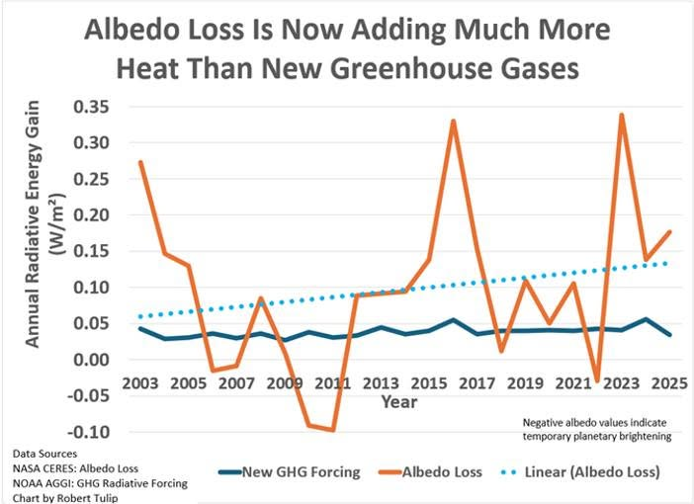

Slide 16
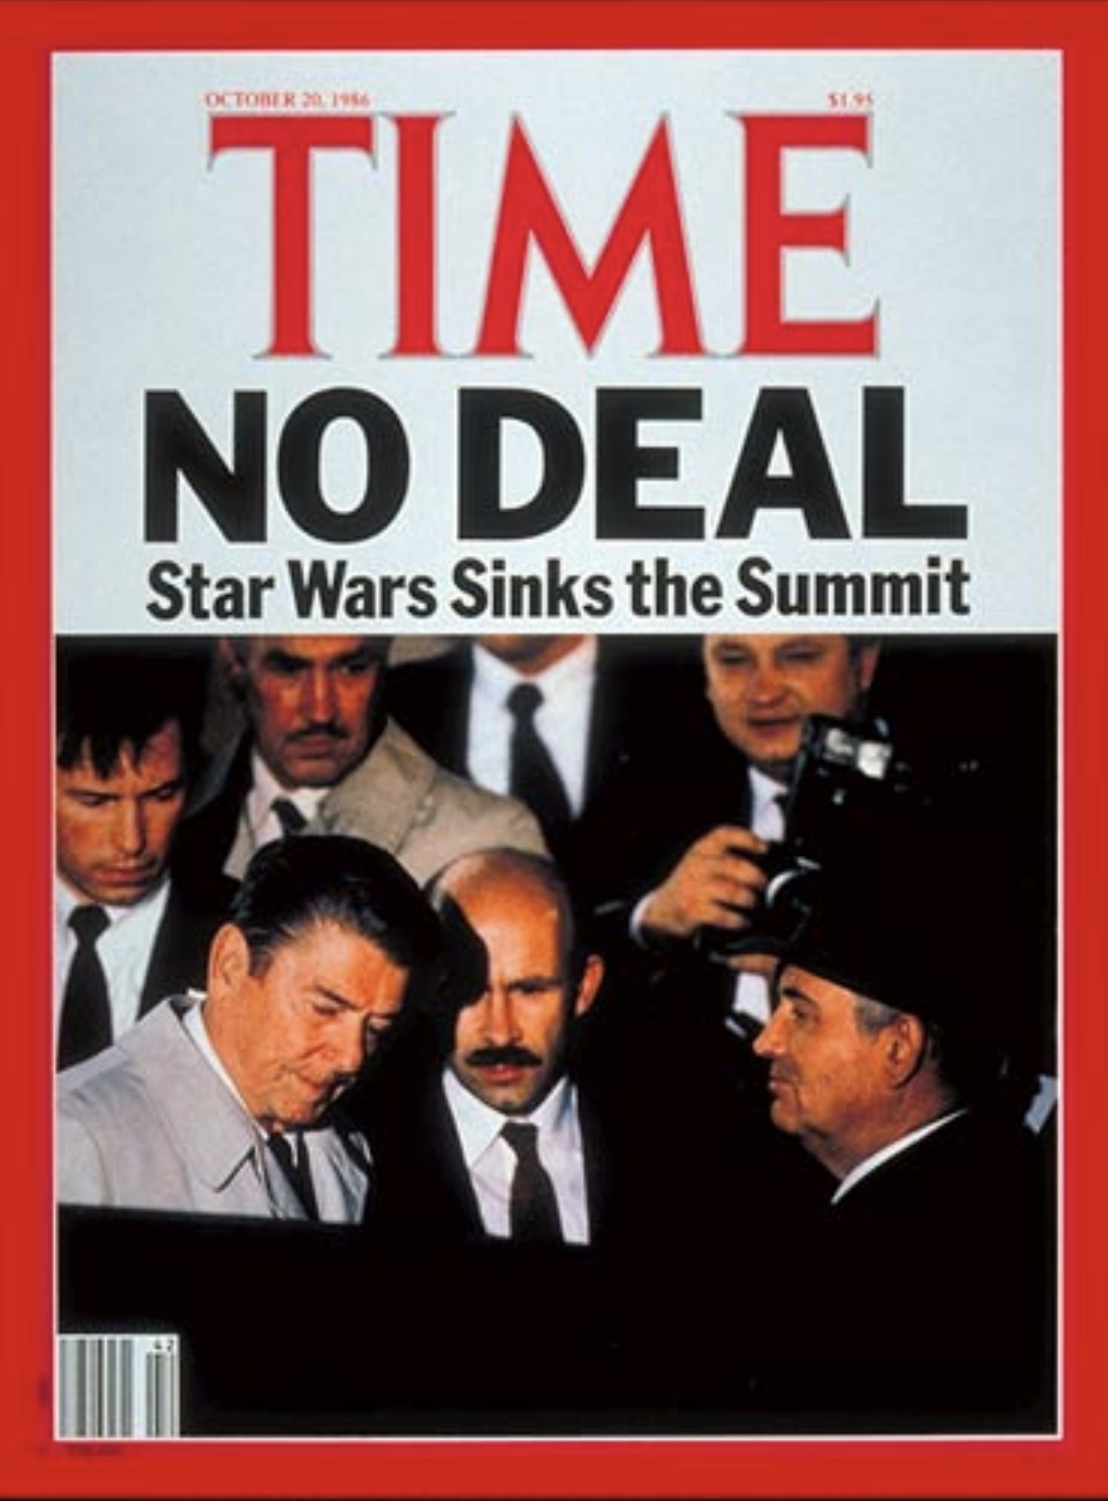

Slide 17
[President Reagan] said that if he thought the [SDI] benefits would not be given to others, he would give up the project himself.
Drafted: T.W. Simons, Jr. 10/11/86

Slide 19
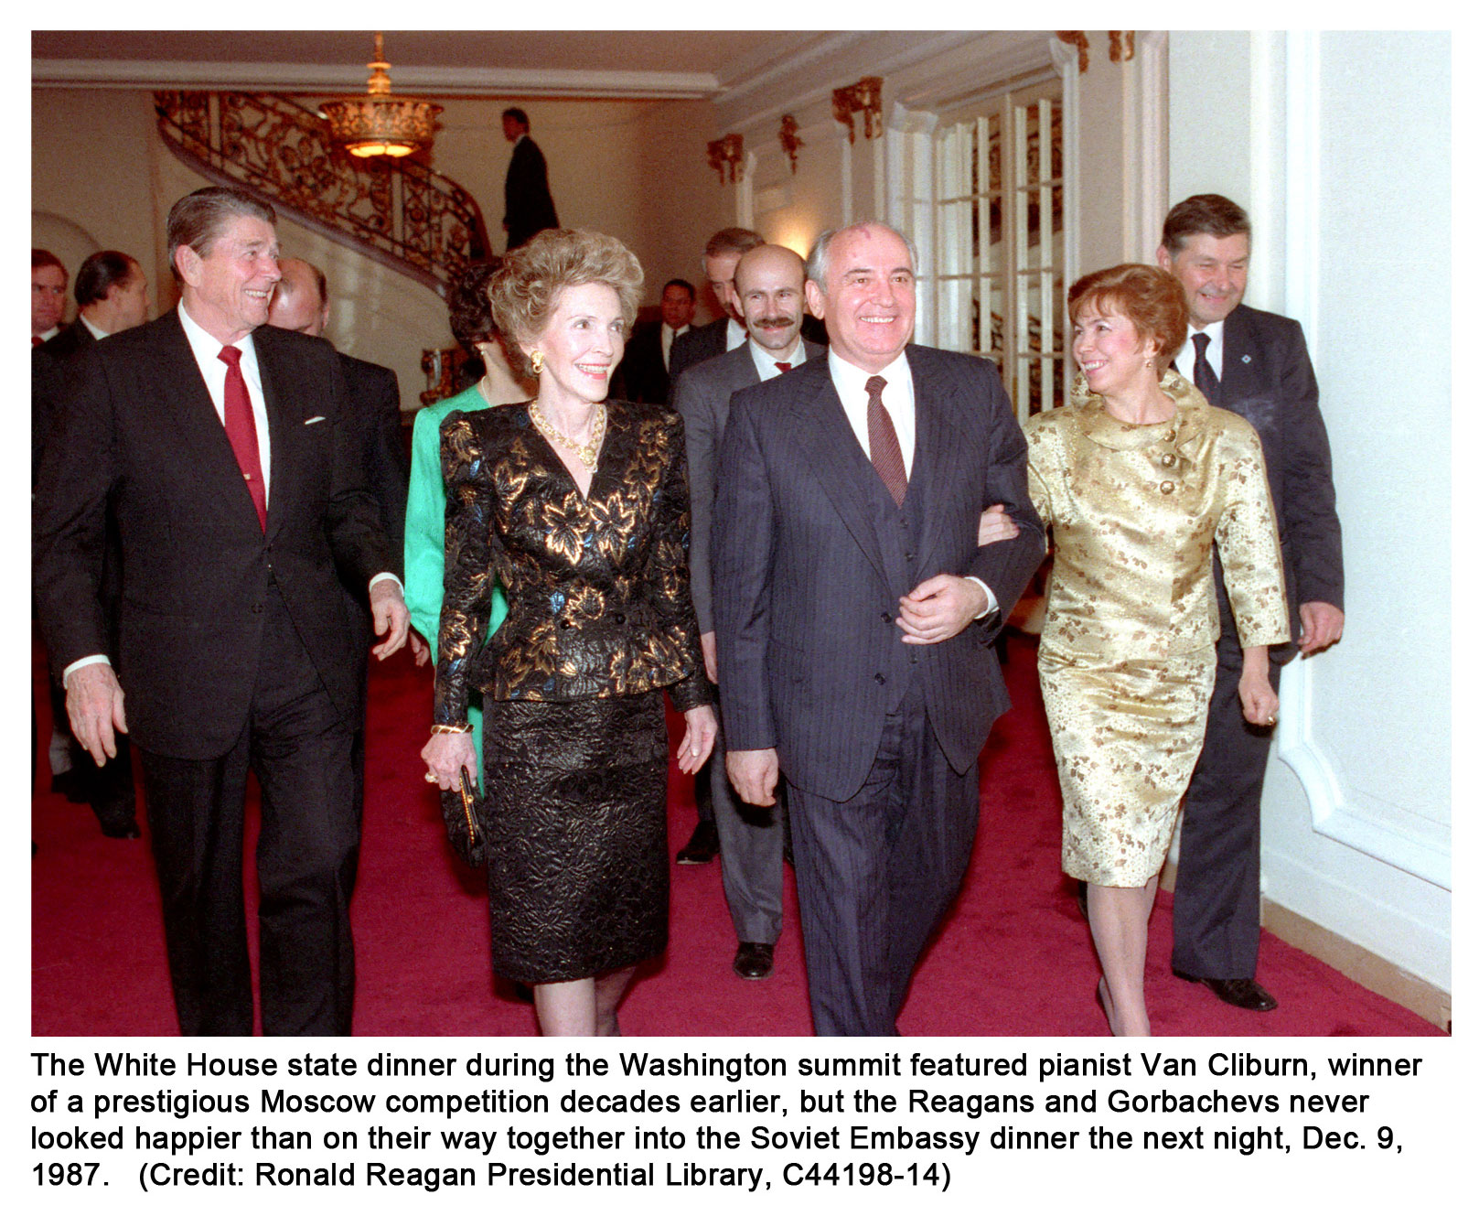

Slide 21


Slide 22
